Slide 1
Working with Files

Slide 2
Contents
Objectives
Describe the basics of input and output in Java
Read data from and write data to a file
Contents
Managing application data by using Reader and Writer classes
Accessing Files and Directories using the File Class
Hands on Labs
Write a program that practices processing simple files.

Slide 3
Java & C# provide classes to perform input/output (I/O)
Referred to an Input-Output channel as a ‘stream’.
Stream represents an input source or an output destination like:
Disk files, devices
Other programs
Memory arrays
Basics of
File I/O
Notes:
Streams can simply pass on data, or manipulate and transform the data into different types of data eg .bytes from a raw datasource but your program ends up processing a Java String.

Slide 4
Java: IO Exceptions
Any method that performs IO must handle the IO exceptions
Or declare itself as throwing IOException
You'll cover ‘Exception Handling’ in the next course
For now, pass the buck by adding throws IOException
C# compiler requires no checked exception handling
import java.io.*;
public class Program {
public static void main(String[] args) throws IOException {
readData();
}
private static void readData() throws IOException {
File file = new File("customers.json");
// more code to read the file ...
}
}
Notes:
All will become clear later in the course but basically Java allows a method signature to acknowledge that sometimes it fails by throwing an unhandled exception. Because this is part of the syntax and not a ‘comment’, any client calling code can be spotted by the compiler as calling a method which potentially throws an exception spo the compiler makes you either ‘handle it’ or ‘pass the buck’ – this week we just ‘pass the buck’ which means your code will crash and burn with FileNotFoundException if you supply any files names that are misspelt or mislocated in your lab work.

Slide 5
Java: Read a text file line by line
import java.io.*;
public class Program {
public static void main(String[] args) throws IOException {
readData();
}
private static void readData() throws IOException {
File file = new File("customers.json");
BufferedReader br = new BufferedReader(new FileReader(file));
String line;
while ((line = br.readLine()) != null)
System.out.println(line);
br.close();
}
}

Slide 6
Java: Appending to files
public static void main(String[] args) throws IOException {
appendFile("c:\\staff.dat", "Nigel London QAA Trainer ");
appendFile("c:\\staff.dat", "Saeed London QAA Trainer ");
}
public static void appendFile(String inFile, String line) throws IOException {
BufferedWriter out = new BufferedWriter(new FileWriter(inFile, true));
out.write(line);
out.close();
}
append
Mike London QA TrainerNigel London QAA Trainer Saeed London QAA Trainer
No \n is written

Slide 7
C# read a file Line by line example
using System;
using System.IO;
class Program {
static void Main(string[] args) {
FileStream fs = File.Open(@"C:\customers.json", FileMode.Open);
StreamReader sr = new StreamReader(fs);
string line;
while ((line = sr.ReadLine()) != null)
Console.WriteLine(line);
sr.Close();
}
}
Simple method
foreach (string line in File.ReadLines(@"C:\qa\customers.json"))
Console.WriteLine(line);
Notes:
Two methods are shown on the slide. Use the first method for more control over how data is read, in particular when the file is very large. Use the second method when you just want to read a small text file's content into memory.
The File class provides the basic functionality to open file streams for reading and writing. It supports a variety of Open methods:
Open, OpenText, OpenRead and OpenWrite
The FileMode enumeration is used to specify how a file is to be opened or created. FileMode.Open opens an existing file. The FileAccess enumeration is used to determine the rights required when opening a table. FileAccess.Read is used to gain read-only access to its contents.
If all you want to do is read out the entire file the ReadAllText method hides all the details of the stream and reader implementation:
Console.WriteLine(File.ReadAllText(@”C:\boot.ini”);

Slide 8
C# append to a file
StreamWriter sw = File.AppendText(@"c:\qa\data.txt");
sw.WriteLine("this is line 1");
sw.WriteLine("this is line 2");
sw.Close();

Slide 9
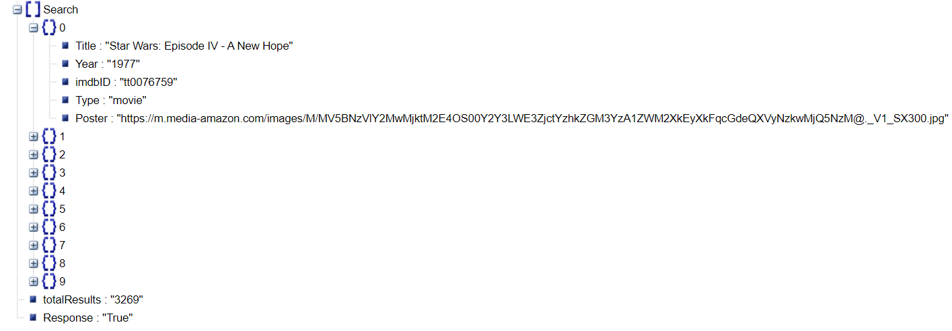

What is JSON?
JSON stands for JavaScript Object Notation
It is used to store objects as text and transport data usually from a server to a client
Restful requests often return JSON content.
http://www.omdbapi.com/?apikey=ef5e4257&s=star

Slide 10
Processing JSON
JDK has no built-in support for creating, parsing, and processing JSON
You can use many open source libraries available like Jackson, Google GSon, json-simple https://javarevisited.blogspot.com/2016/09/top-5-json-library-in-java-JEE.html#ixzz6dCKsXWG7
You will use GSon to read JSON data

Slide 11
Use Streams to Read and Write data
JSON
Review

Slide 12
Hands On Labs
Write code that investigates File System IO classes

